Slide 1
MySQL REPEAT Loop
The REPEAT statement executes one or more statements until a search condition is true.
Here is the basic syntax of the REPEAT loop statement:
[begin_label:] REPEAT
statement
UNTIL search_condition
END REPEAT [end_label]

Slide 2
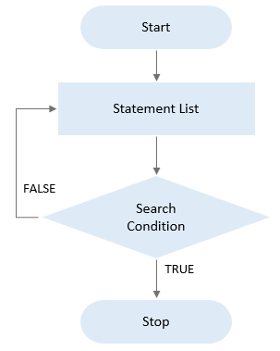
The following flowchart illustrates the REPEAT loop:

Slide 3
MySQL REPEAT loop example
This statement creates a stored procedure called RepeatDemo that uses the REPEAT statement to concatenate numbers from 1 to 9:
DELIMITER $$
CREATE PROCEDURE RepeatDemo()
BEGIN
DECLARE counter INT DEFAULT 1;
DECLARE result VARCHAR(100) DEFAULT '';

Slide 4
REPEAT
SET result = CONCAT(result,counter,',');
SET counter = counter + 1;
UNTIL counter >= 10
END REPEAT;
-- display result
SELECT result;
END$$
DELIMITER ;

Slide 5
In this stored procedure:
First, declare two variables counter and result and set their initial values to 1 and blank.
The counter variable is used for counting from 1 to 9 in the loop. And the result variable is used for storing the concatenated string after each loop iteration.
Second, append counter value to the result variable using the CONCAT() function until the counter is greater than or equal to 10.

Slide 6
The following statement calls the RepeatDemo() stored procedure:
CALL RepeatDemo();
Here is the output:
+--------------------+
| result |
+--------------------+
| 1,2,3,4,5,6,7,8,9, |
+--------------------+
1 row in set (0.02 sec)
Query OK, 0 rows affected (0.02 sec)

Slide 7
Thank You
Please Subscribe My Channel
https://www.youtube.com/channel/UCYW3PWPOPn3qgxxjhUbXXXg?view_as=subscriber

